Slide 1
Composition
Photographic

Slide 2
Good Composition
“Just because something looks cool in real life doesn’t mean you can simply point a camera at it and get a good picture” – Ben Long
“Good composition is the process of arranging forms and tones in a way that is pleasing and that guides the viewer’s eye to bring attention to your subject.” – Ben Long

Slide 3
Simple Techniques for All
The following are a few simple compositional rules that will work for all photos and shooting.

Slide 4
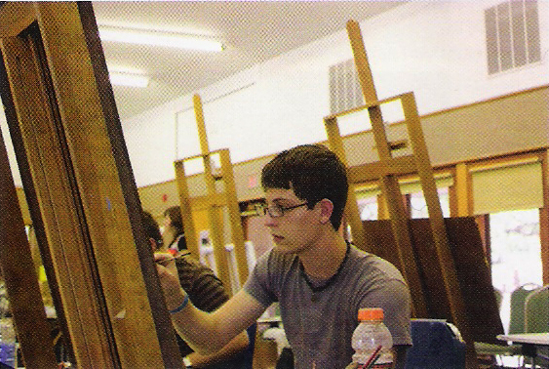
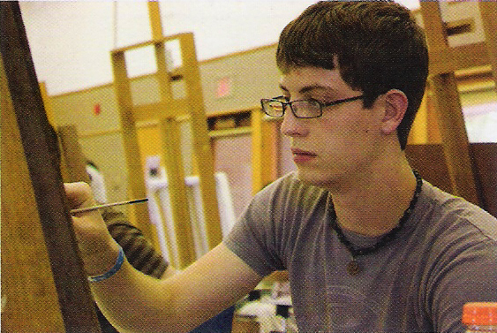
Fill the Frame
Watch the head room
Space above and around the subjects head isn’t necessary unless you want to reveal more details about the setting they’re in
Fill the frame with the subject instead (remember, narrow your focus)
Complete Digital Photography, Long
Complete Digital Photography, Long

Slide 5
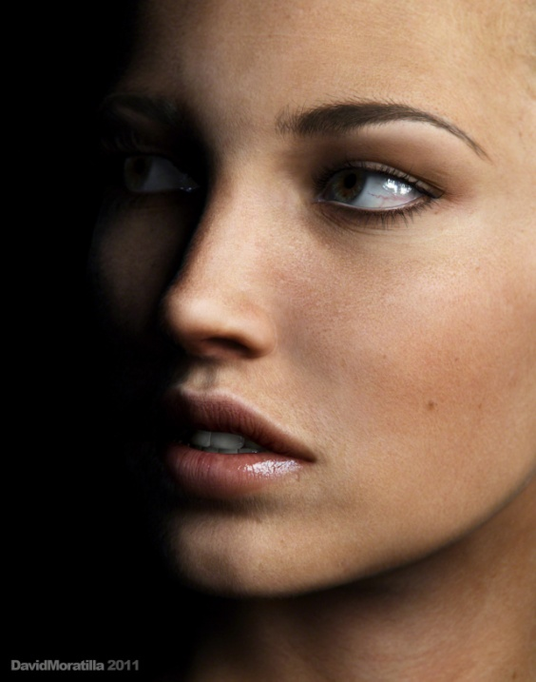
Get in Close
Running part of the subject off the frame isn’t bad
The top of the head, an ear, it’s ok
The closer you get the more intimate the shot will be
It’s generally best to crop at a joint (elbow, knee, etc.)

Slide 6
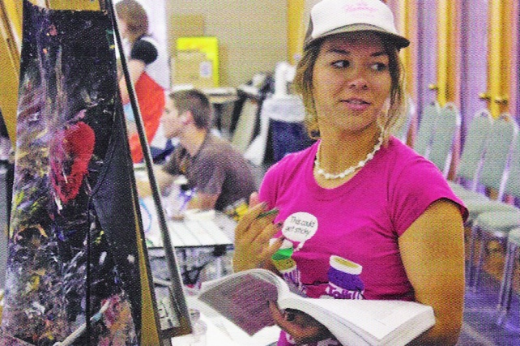
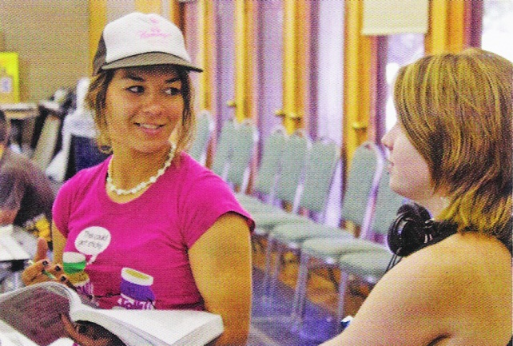
Lead your Subject
If your subjects gaze falls on an object outside of the frame, give them some space to look.
Move them from the center so more of the area they are looking at is in frame.
Even if you can’t see what their looking at it helps to lead them.
Complete Digital Photography, Long
Complete Digital Photography, Long

Slide 7
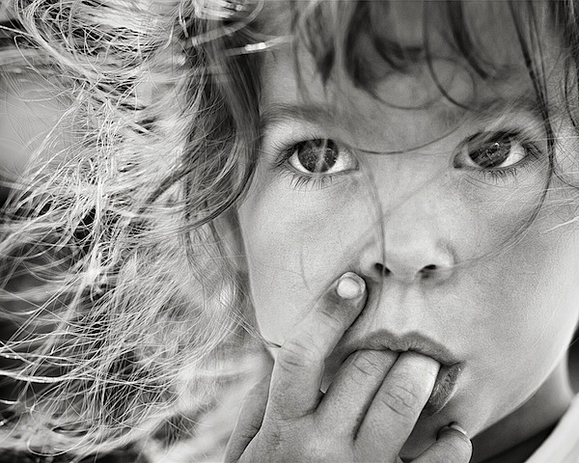
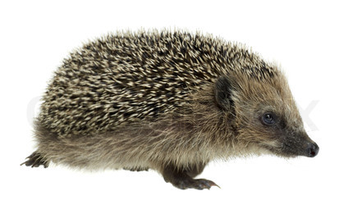
Get Down
Try kneeling to get at your subjects eye level.
This is even more important when photographing children and animals
http://www.colourbox.com/image/low-angle-shot-of-a-walking-hedgehog-image-2728600
http://digital-photography-school.com/how-to-photograph-children

Slide 8
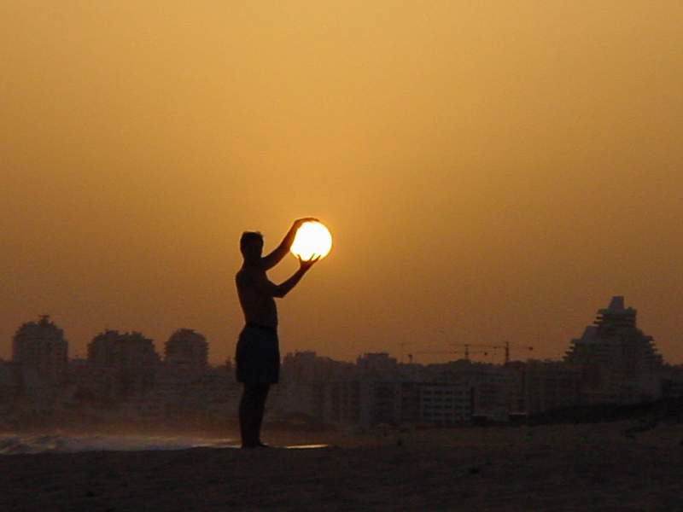
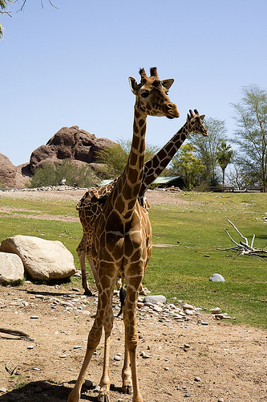
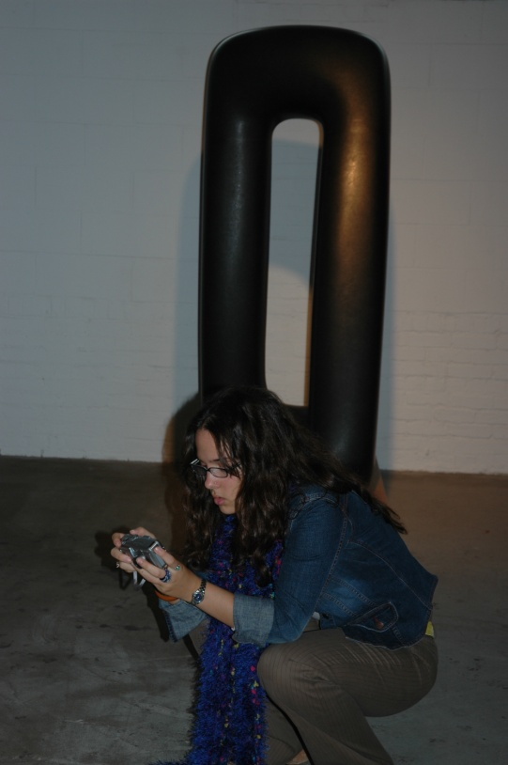
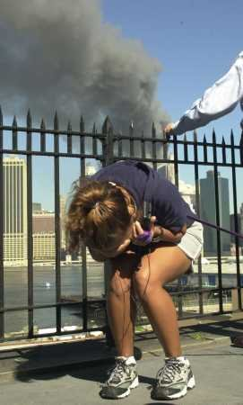
Watch the Background
Arrange your shot to avoid distracting or misleading mergers of the background and the subject.
http://www.immaculateheartacademy.org/outside2/art/garnes/DP%20%20DIGITAL%20PHOTOGRAPHY/DP%20ASSIGNMENTS%20&%20IMAGES/DP%20COURSE%20PROJECTS/DP%20STUDY%20II%20VALUE,%20TONE,%20MERGER,%20TEXTURE.htm
http://angelicaphotojournalismblog.blogspot.com/2010/09/avoiding-mergers.html
http://www.beyondmegapixels.com/2010/04/composition-tip-avoid-mergers/

Slide 9
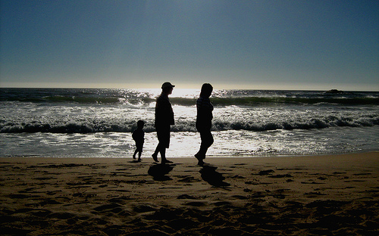
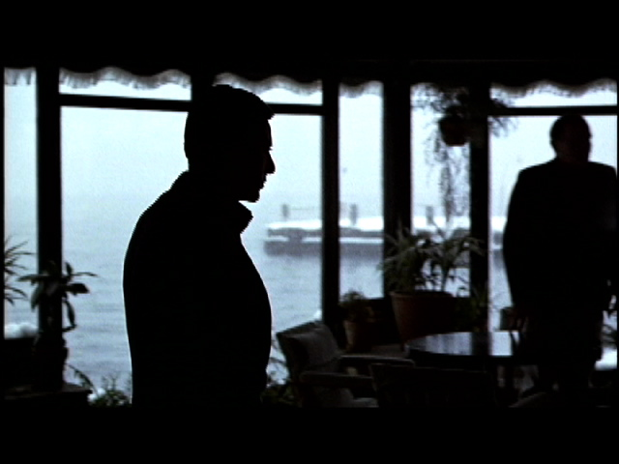
Watch Out for Backlighting
If there is light coming from behind the subject, you are dealing with backlighting.
It’s great for making silhouettes, but not always desirable.
Using backlighting can be a great tool, but requires practice.
http://oahlukeberry.blogspot.com/2010/11/lighting.html
http://www.digitalcamerastyle.com/backlight-photography

Slide 10
Advanced Composition
The following ideas will help you get the most out of more complex subjects.

Slide 11
Just a reminder
These are only guidelines. They won’t work for every shot.
They can be combined with other guidelines.
As with any rule, they are made to be broken.

Slide 12
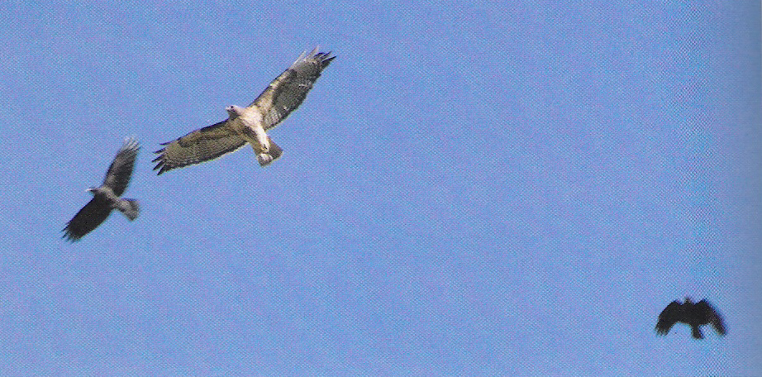
Balance
Each object in a photo has weight.
Position objects so they are balanced.
Location can also affect balance.
This is known as informal balance because of its flexibility.
Complete Digital Photography, Long
Complete Digital Photography, Long

Slide 13
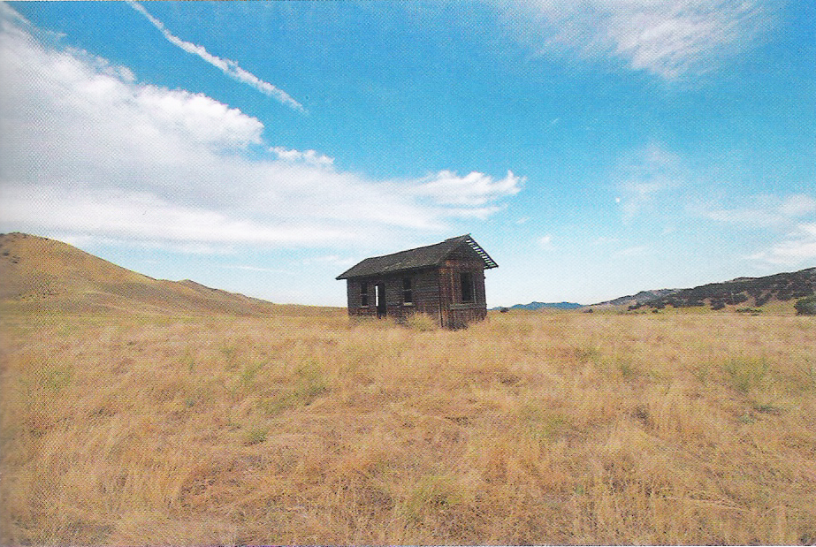
Balance
Placing an item in the center can create a symmetrical balance, which makes the shot more formal.
Complete Digital Photography, Long

Slide 14
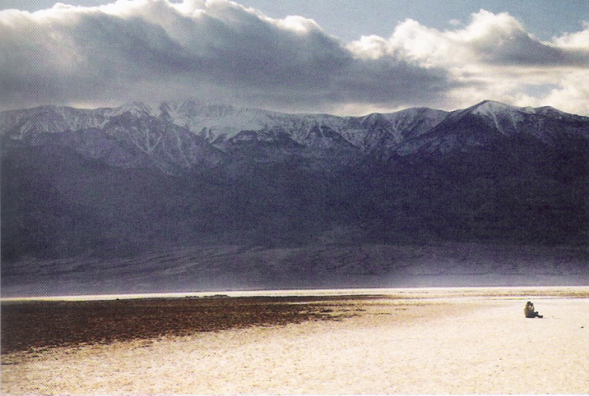
Balance
It’s difficult to balance elements because of their weights.
A pillow is larger than a shot put, but the shot put has much more weight.
Sometimes even empty space in a photo can have a weight and act to balance a photo.
People have significant weight.
Complete Digital Photography, Long

Slide 15
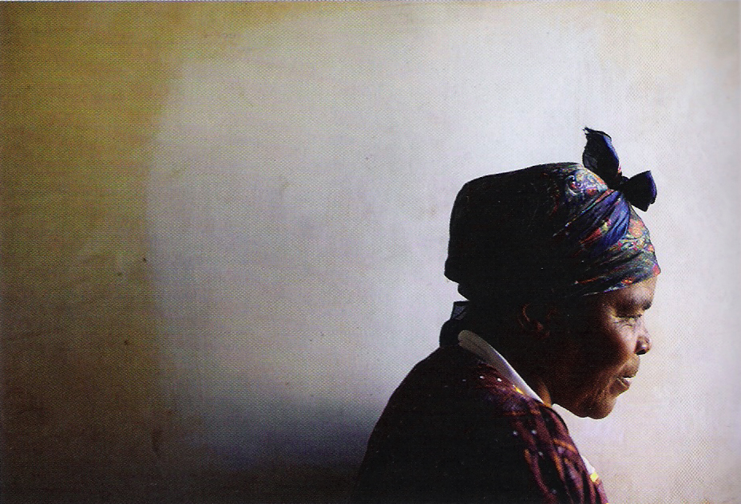
Balance
Balance can get deep.
This example works because of the deep in thought nature of the woman's face.
The empty space behind her acts as her thoughts, like a bubble in a cartoon, minimizing the weight of the woman.
Complete Digital Photography, Long

Slide 16
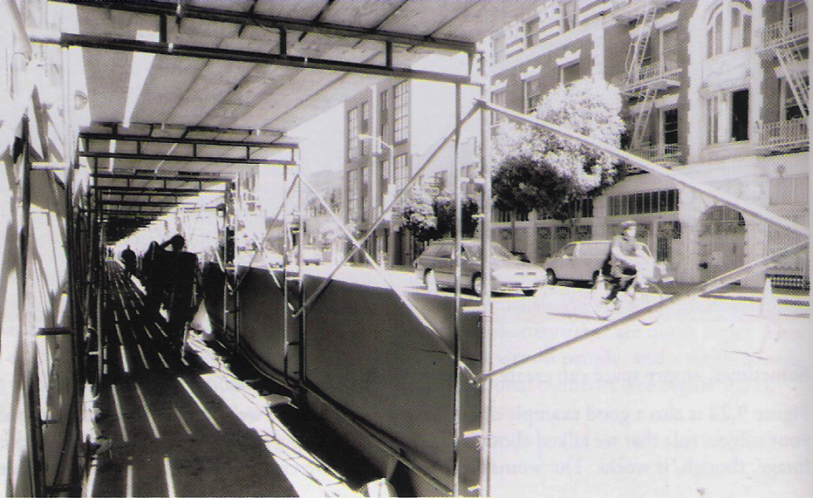
Balance
You can also balance your image by tones
The right side is balanced here by the darkness on the left side.
Complete Digital Photography, Long

Slide 17
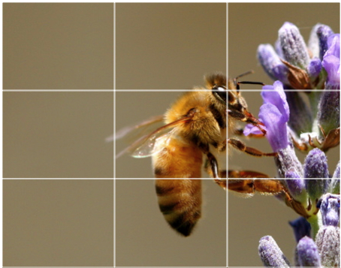
Rule of Thirds
Dividing an image into thirds and placing the subject on one of the intersecting lines can make your photos better.
http://digital-photography-school.com/rule-of-thirds
http://cosmicexposure.com/sites/mediagallery/tutorials/photography-compositions/rule-of-thirds

Slide 18
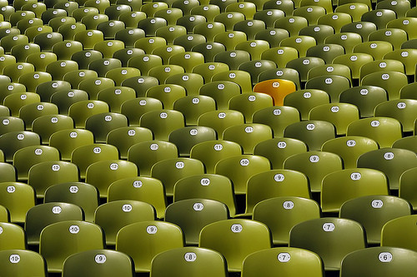
Repetition
Repeating patterns often make good pictures.
http://www.betterphoto.com/gallery/dynoGall2.asp?catID=1011
Complete Digital Photography, Long
http://www.craigfergusonimages.com/2010/05/urban-patterns/
http://vi.sualize.us/the_lonely_crowd_nightphotographer_seat_stadium_repeion_green_picture_z9P.html

Slide 19
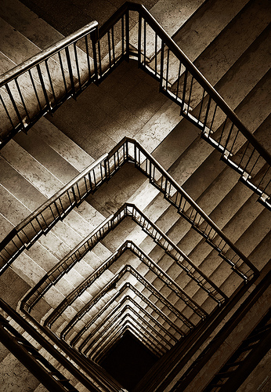
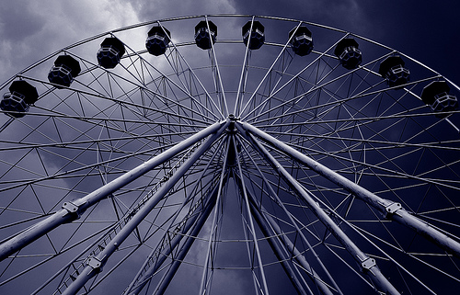
Geometry
Geometric patterns are interesting photos.
http://www.lightstalking.com/21-clever-uses-of-geometric-patterns-in-photography
http://www.lightstalking.com/21-clever-uses-of-geometric-patterns-in-photography

Slide 20
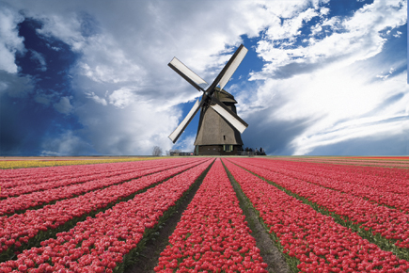
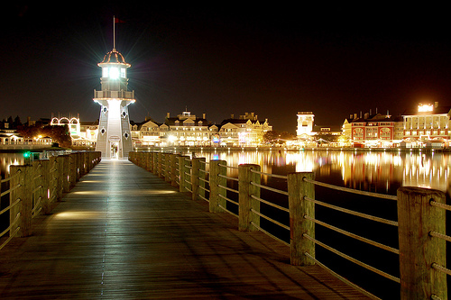
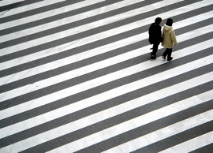
Lines
Using lines in a composition makes appealing pictures.
They can also be used to lead the eye in a particular direction.
http://digital-photography-school.com/using-diagonal-lines-in-photography
http://www.photographic.com/issue-2-mastering-composition/0409LINES/
http://dasoms-stories.blogspot.com/2011/02/leading-lines.html

Slide 21
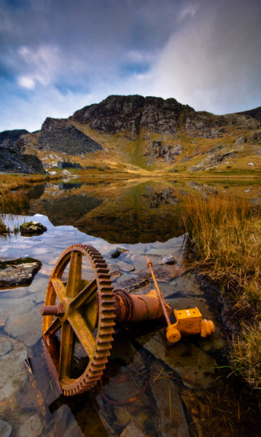
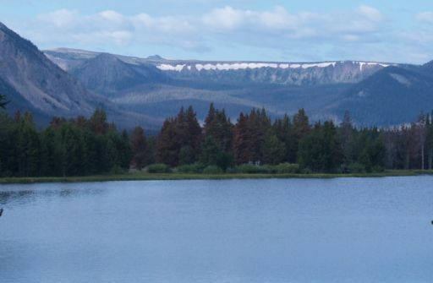
Foreground/Background
Every photo needs a background and foreground.
Creates depth in a shot
Creates a meaningful and complex image
http://www.photoanswers.co.uk/Advice/Search-Results/Photopedia/Foreground-Interest/
http://photosandponders.blogspot.com/
http://www.cougaruteforum.com/showthread.php?t=9506&page=5

Slide 22
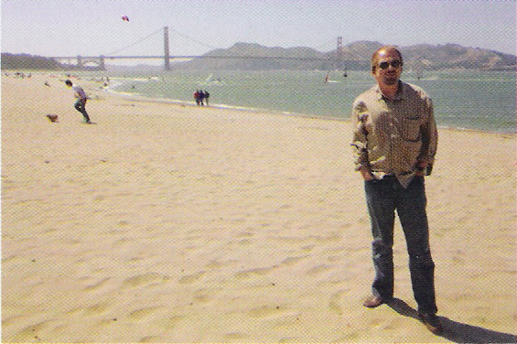
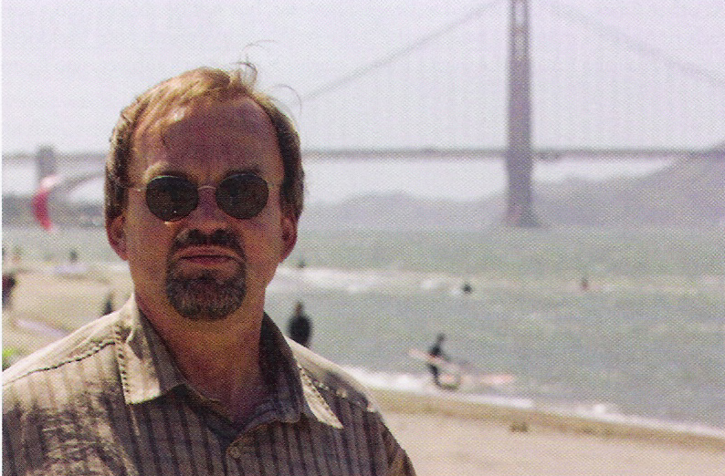
Foreground/Background
Decide what the subject is and what the background should be.
This is often only a matter of framing.
Complete Digital Photography, Long
Complete Digital Photography, Long

Slide 23
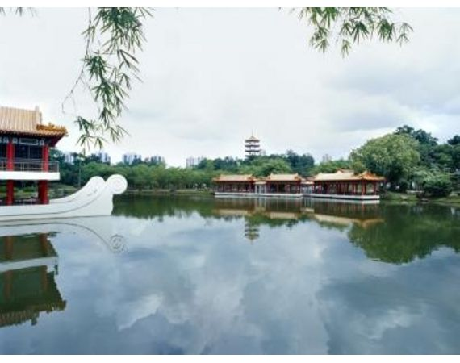
Foreground/Background
Sometimes it’s difficult to tell the division between the background and the foreground
http://www.ehow.com/how_8419119_background-foreground-focus-camera.html

Slide 24
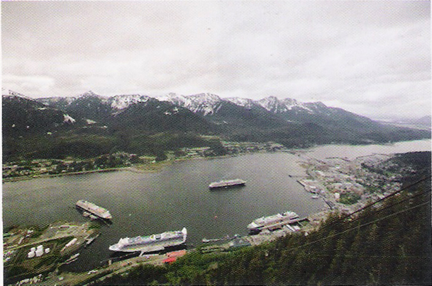
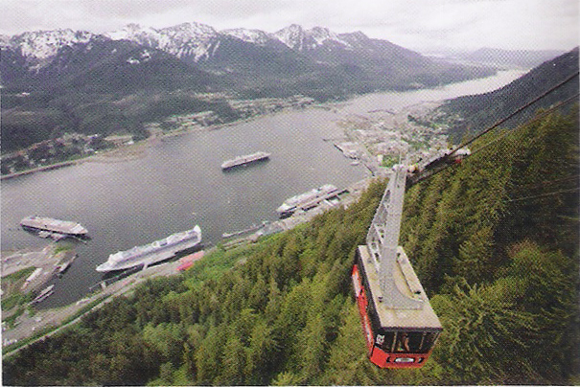
Foreground/Background
Even the most breathtaking shots need a subject to make them complete.
This shot includes a background and a foreground but still doesn’t feel whole.
With the cable car in the shot, there is a subject to complete the shot.
Complete Digital Photography, Long
Complete Digital Photography, Long

Slide 25
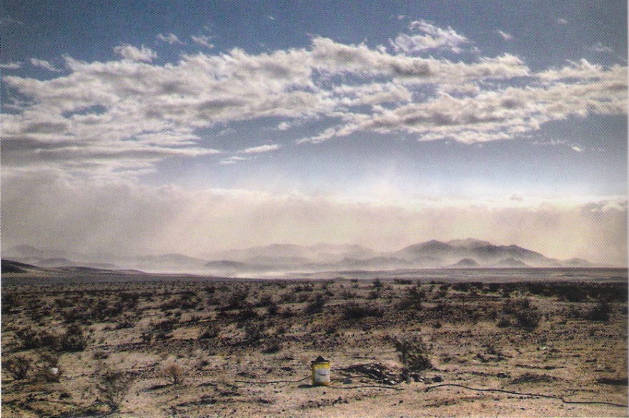
Foreground/Background
Be patient
Someone may walk into a shot and make a good subject.
Change the location slightly to include another object as a subject.
Complete Digital Photography, Long

Slide 26
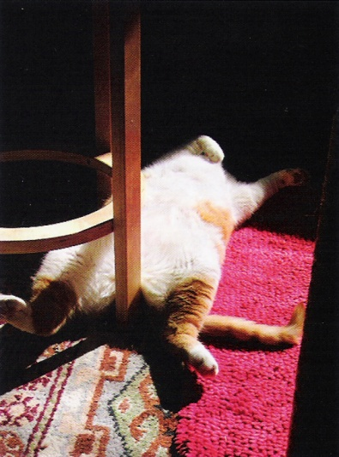
Composing with Light & Dark
Balancing can be done with tone, was we discussed earlier.
This is also an important consideration for building a picture.
Light is the most important thing in photography
Sometimes darkness in some areas of a photo is good.
It simplifies an image.
It directs focus to the subject instead of the background.
Complete Digital Photography, Long
Complete Digital Photography, Long

Slide 27
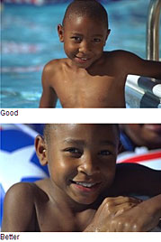
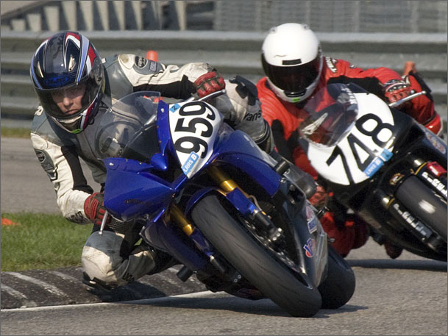
Less is More
One of the more important things you can as a photographer is simplify.
It’s difficult because the world is a crowded place.
A misplaced tree branch can cause a merger or just be a distraction.
Too much clutter distracts form the subject.
Filling the frame will help to narrow the focus.
Get in closer. This will reduce clutter too.
http://lifehacker.com/141169/photography-tip-of-the-day--get-in-close
http://www.boston.com/community/photos/raw/2008/08/stop_filling_the_frame.html

Slide 28
Let’s Review
Get in close
Fill the Frame
Lead your Subject
Get down
Watch the Background
Watch out for Backlighting
Balance
Rule of Thirds
Repetition
Geometry
Lines
Foreground/Background
Light & Dark
Less is more
These can be mixed and matched
Rules are made to be broken… if done correctly

